Slide 1
Musculoskeletal, Cardiovascular, Excretory Systems: Revision

Slide 2
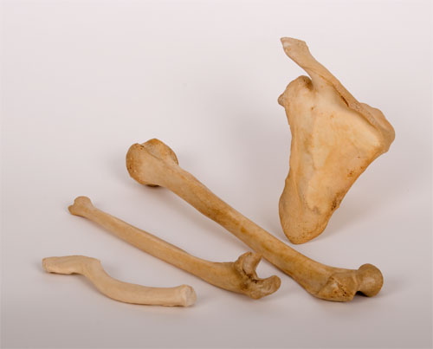
Concept Development
CFU 1
What are the three characteristics of bones?
Vocabulary
Characteristic: Feature or quality Elastic: able to return to its normal shape after being stretched or compressed
Characteristics of Bones
Bones need to be strong so they don’t snap under normal activity.
They must be light so they can be moved by muscles.
They must be elastic so they can be compressed and stretched without breaking.
CFU 2
Why do bones need to be elastic?
CFU 3
Which characteristic of bones allows them to be moved easily?

Slide 3
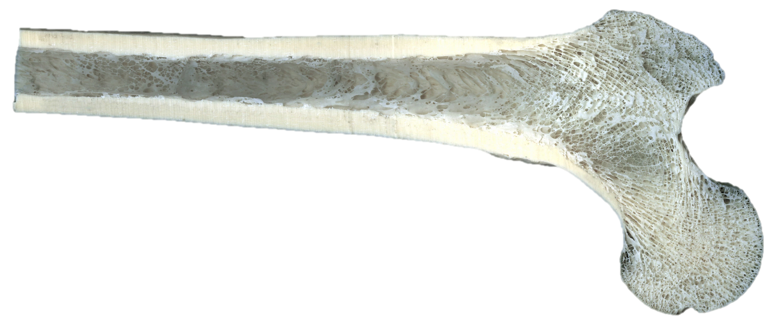
Concept Development
CFU 1
What are the two types of bone tissue?
Vocabulary
Porous: has many holes
Structure of Bones
There are two types of bone tissue:
Compact bone is dense and heavy. This gives bone its strength.
Spongy bone is porous and looks like honeycomb. The spaces in the bone make it light.
Fun Fact
The gaps in spongy bone are filled with bone marrow, a soft, jelly-like substance. This is where red blood cells are made.
CFU 32
Which label represents spongy bone and which represents compact bone? Explain your choice.
B
A

Slide 4
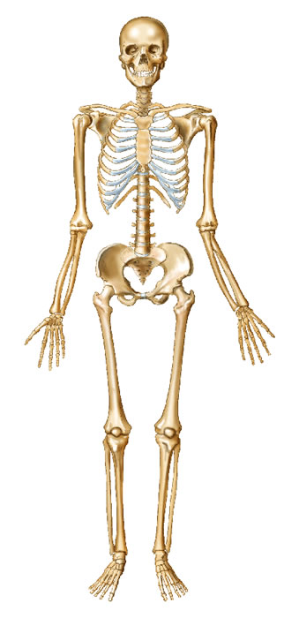
Concept Development
Skull
Clavicle
Major Bones in the Human Body
Ribs
CFU 1
Which three bones make up the human arm?
Humerus
Radius
CFU 2
Which bones protect the lungs and heart?
Ulna
CFU 3
What organ does the skull protect?

Slide 5
Concept Development
Major Bones in the Human Body
CFU 1
Which bones make up the human leg?
Vertebrae
CFU 2
Which organ do the vertebrae protect?
Pelvis
Femur
CFU 3
What is the common name for the patella?
Patella
Tibia
Fibula

Slide 6
Concept Development
CFU 1
What are the two parts of the skeleton?
Vocabulary
Vital organ: An organ you cannot live without eg. brain, lungs, heart
Skull
Clavicle
Axial Skeleton and Appendicular Skeleton
The skeleton can be divided into two general parts:
The axial skeleton – bones that protect vital organs
The appendicular skeleton – bones that allow movement
Ribs
Humerus
Vertebrae
Radius
Pelvis
Ulna
Femur
CFU 2
How is the axial skeleton different to the appendicular skeleton?
CFU 3
Which part of the skeleton does the skull belong to? Explain your choice.
Patella
Tibia
Fibula

Slide 7
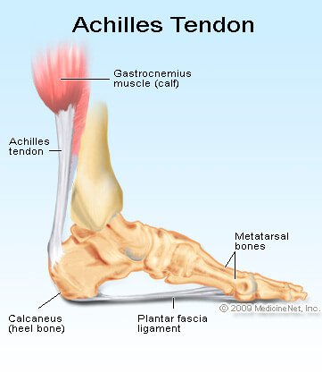
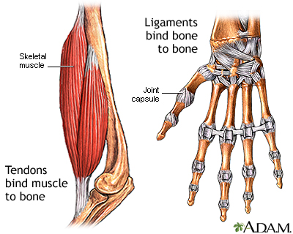
Concept Development
CFU 1
How are tendons and ligaments similar?
CFU 3
The Achilles tendon runs down the back of the heel. What is its function?
Tendons and Ligaments
Tendons and ligaments are tough bands of tissue.
Tendons connect muscles to bones.
Ligaments hold bones together.
CFU 2
How are tendons and ligaments different?

Slide 8
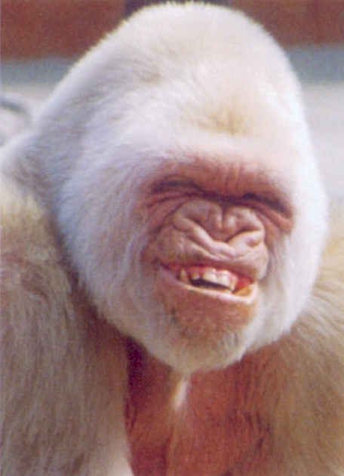
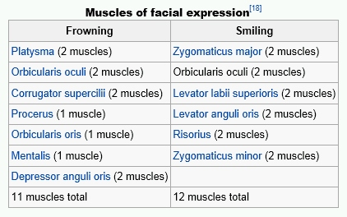
Concept Development
CFU 1
Do muscles push or pull?
Muscles
Muscles are able to contract.
They pull on the bone they are attached to, via a tendon, causing the bone to move.
Muscles can only pull, they cannot push.
Another muscle is needed to move the bone back to its original position.
CFU 2
When muscles contact, what happens to the bone they are attached to?
CFU 3
How is a bone moved back to its original position?
Did You Know?
It takes more muscles to frown than it does to smile!

Slide 9
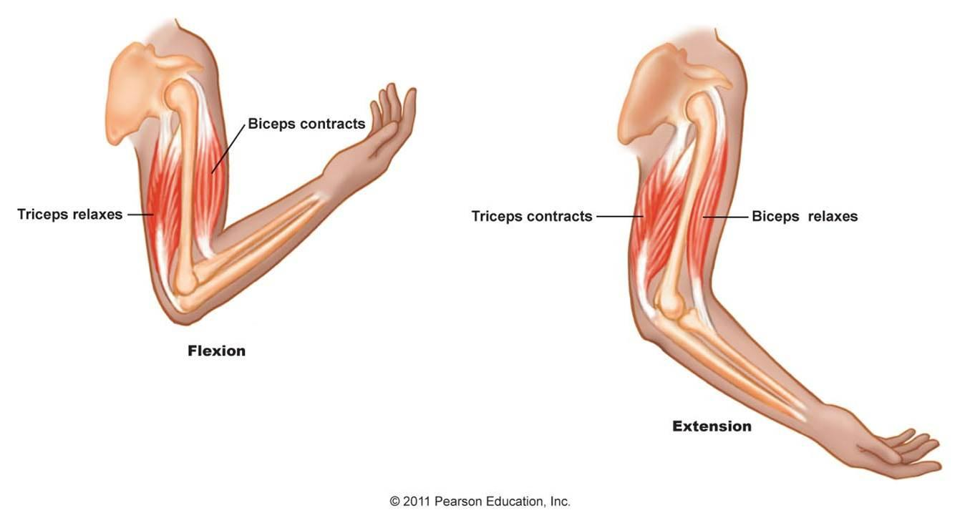
Concept Development
CFU 1
What is an antagonistic pair of muscles?
Antagonistic Muscles
Muscles are arranged in antagonistic pairs that work in opposition to each other.
The biceps and triceps are an antagonistic pair.
The biceps contracts, raising the arm.
The triceps contracts, lowering the arm.
CFU 2
Explain how the biceps and triceps work as an antagonistic muscle pair.
Vocabulary
Antagonistic: acting in opposition

Slide 10
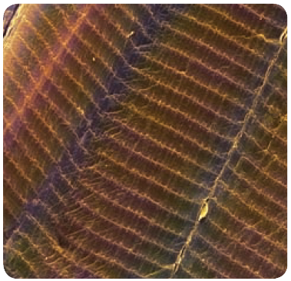
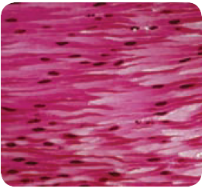
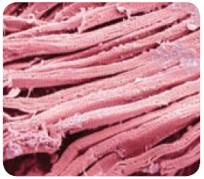
Concept Development
CFU 1
What is an example of a voluntary muscle?
Types of Muscles
Skeletal muscles are voluntary, and move the bones of the skeleton.
Smooth muscles are involuntary, and help our internal organs carry out functions such as breathing and digestion.
Cardiac muscles (heart muscles) allow the heart to beat continuously.
CFU 2
What is an example of a smooth muscle?
CFU 3
Think, Pair, Share: Is cardiac muscle voluntary or involuntary? Explain your choice.

Slide 11
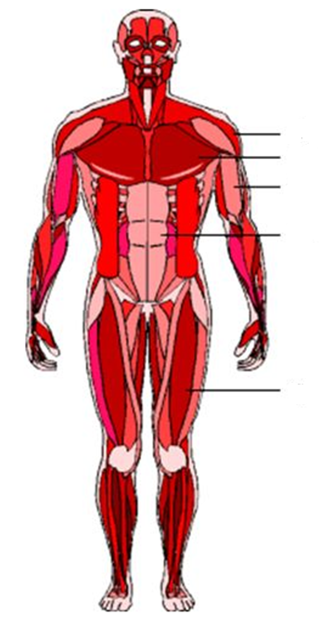
Concept Development
Major Muscles in the Human Body
Deltoidss
Pectorals
CFU 1
Which muscles move the arm?
Biceps
Abdominals
CFU 2
Which muscles cover the abdomen?
CFU 3
Which muscle could also be called the thigh muscle?
Quadriceps

Slide 12
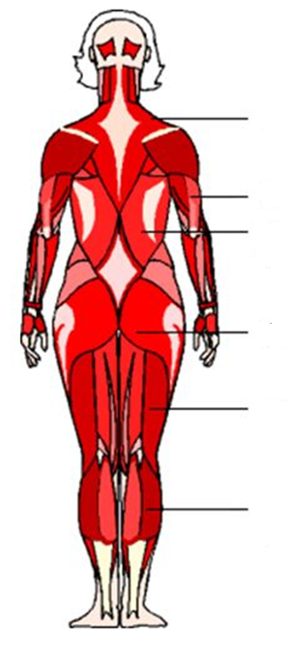
Concept Development
Major Muscles in the Human Body
Trapezius
CFU 1
Which muscle is shaped like a trapezium?
Triceps
Latissimus dorsi
CFU 2
Which muscles create the human ‘bottom’?
Gluteals
CFU 3
What is another name for our calf muscle?
Hamstrings
Gastrocnemius

Slide 13
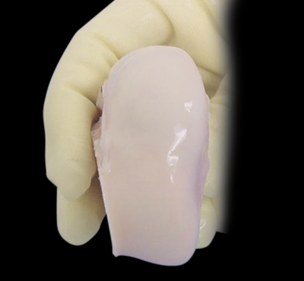
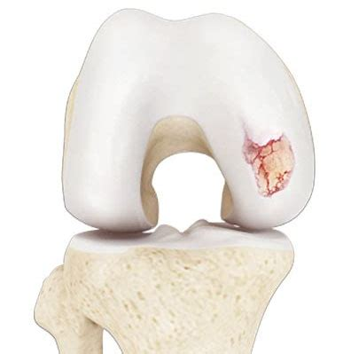
Concept Development
CFU 1
What is a joint?
CFU 2
What covers the ends of bones?
Joints
Joints are where two bones meet.
The ends of bones are covered in a smooth, slippery material called cartilage.
Cartilage reduces friction between the bones when they move.
CFU 3
What is the function of cartilage on the ends of bones?

Slide 14
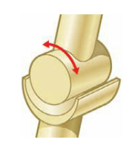
Concept Development
CFU 1
How does a hinge joint move?
Types of Joints - Hinge
Only moves backwards and forwards (like a door hinge)
Examples are the elbow, knee and finger joints
CFU 2
Are the joints in the toes hinge joints? Explain your choice.

Slide 15
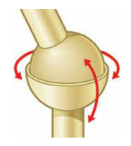
Concept Development
CFU 1
How does a hinge joint move?
Types of Joints – Ball and Socket
Allows movement in all directions
One bone has a ball shaped end that fits into the cup shape of the other bone
Examples are the hip and shoulder
CFU 2
Are the joints in the toes hinge joints? Explain your choice.

Slide 16
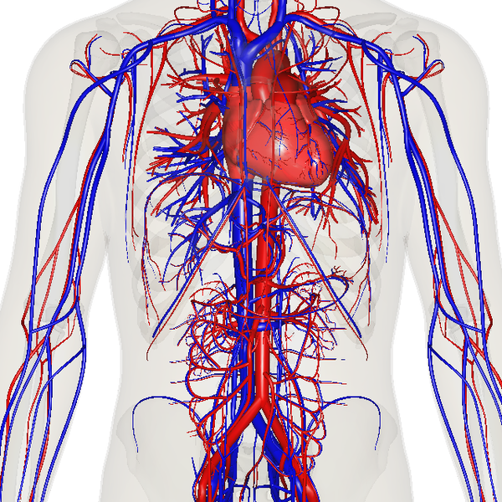
Concept Development
CFU 1
What does the circulatory system do?
The Circulatory System
The circulatory system is a group of organs which work together to transport gases, nutrients, waste products and heat around the body.
This process is known as circulation.
CFU 2
What is circulation?
CFU 3
Would you expect to find sugars in your blood? Why or why not?

Slide 17
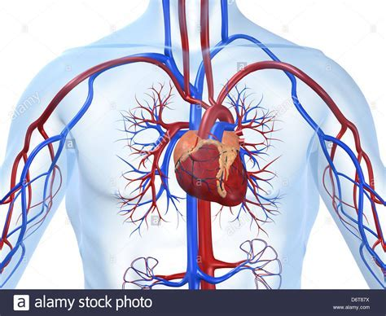
Concept Development
CFU 1
What are the three organs of the circulatory system?
The Circulatory System
There are three organs in the circulatory system:
Heart – a pair of pumps made of cardiac muscle
Blood vessels – tubes which allow the movement of blood throughout the body
Blood – a liquid organ that carries oxygen, nutrients and water to cells, and removes carbon dioxide and waste from cells
CFU 2
What is the function of blood vessels?
CFU 3
Via the blood, oxygen is carried to the cells and carbon dioxide away from the cells. Why is this important?

Slide 18
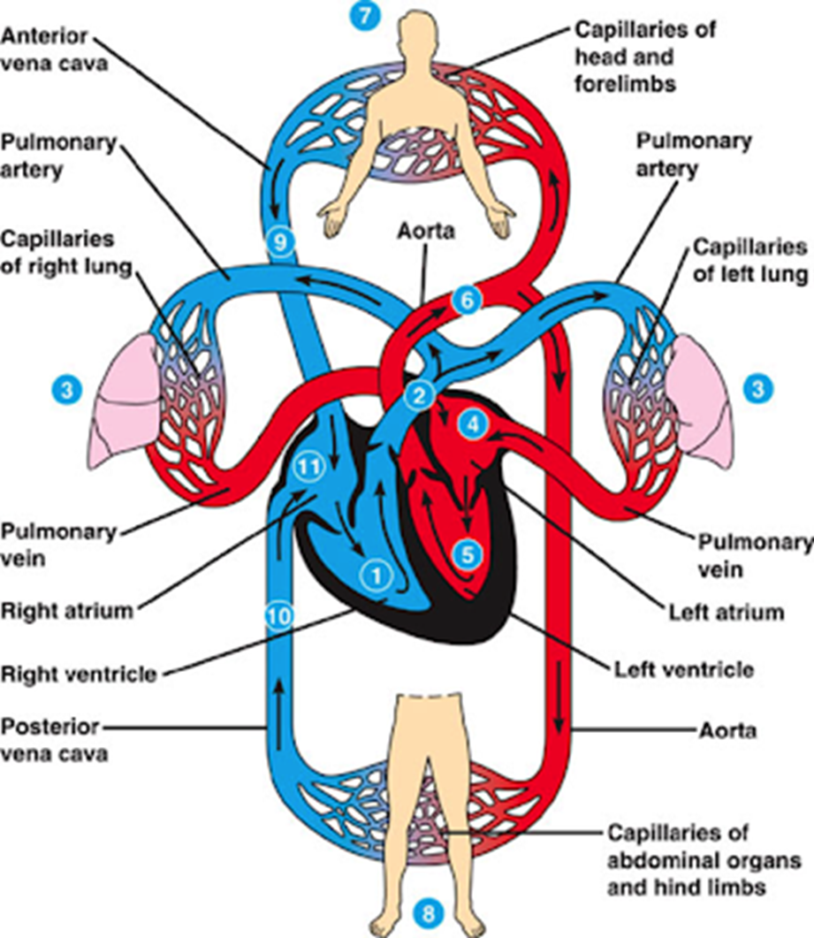
Concept Development
CFU 1
Where is the heart located?
CFU 2
How does the heart move the blood around the body?
The Heart – Function
The heart is a muscular pump located slightly to the left of the middle of the chest, behind the sternum (breastbone).
It is constantly contracting and relaxing, which moves the blood and its contents around the body.
The heart is connected to arteries that carry oxygenated blood (red) to the body’s cells, and veins that carry deoxygenated blood (blue) back to the heart.
CFU 3
What colour represents oxygenated blood?
CFU 4
What colour represents deoxygenated blood?

Slide 19
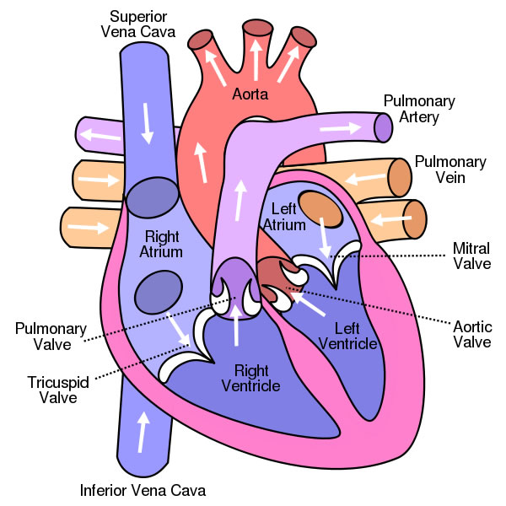
Concept Development
CFU 1
How many chambers does the heart have?
CFU 3
What is the function of the pulmonary vein? Explain how it is different to pulmonary artery.
Parts of the Heart
The heart has four chambers:
Two atria (singular: atrium)
The top two chambers, where blood enters
Two ventricles
The bottom two chambers, which blood is pumped out of
The heart also has four main blood vessels:
Pulmonary Artery – sends blood to the lungs
Pulmonary Vein – receives blood from the lungs
Aorta – sends blood to the body
Vena Cava (superior and inferior) – receives blood from the body
CFU 2
Which blood vessels carry blood away from the heart?

Slide 20

Skill Development
CFU 1
How does deoxygenated blood enter the heart?
CFU 2
Which valves prevent back-flow in the right atrium and right ventricle?
The Heart – Function:
Deoxygenated blood from the body enters the heart through the vena cava.
It enters the right atrium, and is pumped into the right ventricle.
The deoxygenated blood then is pumped out to the lungs through the pulmonary artery.
Valves (tricuspid and pulmonary) prevent blood flowing back the wrong way.
CFU 3
Where does the deoxygenated blood go after leaving the right ventricle? How does it get there?

Slide 21
Skill Development
CFU 1
How does oxygenated blood enter the heart?
CFU 2
What role do the valves play in the heart?
The Heart – Function:
Oxygenated blood from the lungs enters the heart through the pulmonary vein.
It enters the left atrium, and is pumped into the left ventricle.
The oxygenated blood is then pumped out to the body through the aorta.
Valves (mitral and aortic), prevent blood flowing back the wrong way.
CFU 4
What is the difference between the left and right sides of the heart?
CFU 3
How does the blood enter the body from the heart?

Slide 22
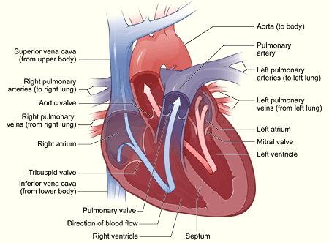
Skill Development / Guided Practice
Describing the path of blood through the heart
1. Identify the starting point on the diagram 2. State whether the blood is oxygenated (red) or deoxygenated (blue) 3. Follow the arrows through the different parts of the heart until the blood exits the heart
Describe the path of blood from the right ventricle.
The deoxygenated blood in the right ventricle goes through the pulmonary artery to the lungs.

Slide 23
Skill Development / Guided Practice
Describing the path of blood through the heart
1. Identify the starting point on the diagram 2. State whether the blood is oxygenated (red) or deoxygenated (blue) 3. Follow the arrows through the different parts of the heart until the blood exits the heart
Describe the path of blood from the left ventricle.
The oxygenated blood in the left ventricle goes through the aorta to the body.

Slide 24
Skill Development / Guided Practice
Describing the path of blood through the heart
1. Identify the starting point on the diagram 2. State whether the blood is oxygenated (red) or deoxygenated (blue) 3. Follow the arrows through the different parts of the heart until the blood exits the heart
Describe the path of blood from the left atrium.
The oxygenated blood in the left atrium goes into the left ventricle, then through the aorta to the body.

Slide 25
Skill Development / Guided Practice
Describing the path of blood through the heart
1. Identify the starting point on the diagram 2. State whether the blood is oxygenated (red) or deoxygenated (blue) 3. Follow the arrows through the different parts of the heart until the blood exits the heart
Describe the path of blood from the vena cava.
The deoxygenated blood goes through the vena cava into the right atrium, then the right ventricle and goes to the lungs through the pulmonary artery.

Slide 26
Skill Development / Guided Practice
Describing the path of blood through the heart
1. Identify the starting point on the diagram 2. State whether the blood is oxygenated (red) or deoxygenated (blue) 3. Follow the arrows through the different parts of the heart until the blood exits the heart
Describe the path of blood from the pulmonary veins.
The oxygenated blood goes through the pulmonary vein into the left atrium, then goes into the left ventricle and goes out through the aorta to the body.

Slide 27
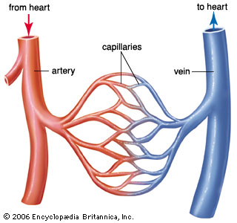
Concept Development
CFU 1
How many types of tubes are there in blood vessels?
CFU 2
Which way does the blood flow in the arteries?
The Circulatory System – Blood Vessels
Blood vessels are made of three types of tubes:
Arteries – have thick, elastic walls and carry blood away from the heart
Veins – have thinner walls and carry blood back to the heart
Capillaries – are only one cell thick and pass oxygen, nutrients and wastes from blood to the cells.
CFU 3
Which way does the blood flow in the veins?
CFU 5
What is the difference between arteries, veins and capillaries?
CFU 4
Which blood vessel are the smallest?

Slide 28
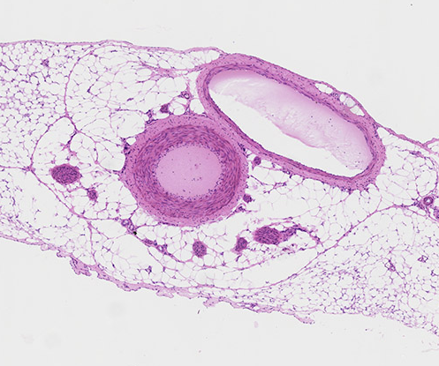
Concept Development
CFU 1
Why does an artery have a thicker wall?
CFU 2
Why are the arteries elastic?
Arteries
Transports blood away from heart.
They have thick, muscular walls to provide strength for high pressure pumping of blood.
They are elastic to maintain blood pressure even when the heart relaxes.
The arteries dilate and constrict, which creates a pulse.
CFU 3
How does the artery create a pulse?
Artery
Vocabulary
Dilate: become wider Constrict: become narrow

Slide 29
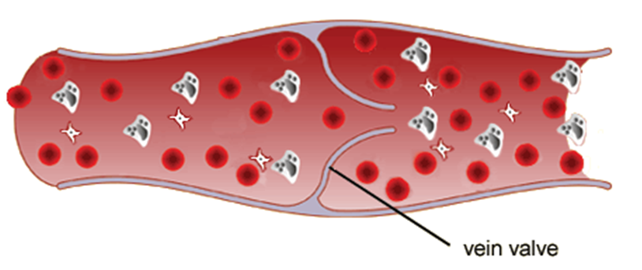
Concept Development
CFU 1
What is being carried by the veins?
CFU 2
Why do veins have thinner walls than arteries?
Veins
Return blood back to heart
They have thinner, more flexible walls
The blood travels at low speed and pressure, due to the distance from the heart.
Veins have one-way valves which allow blood to flow only toward heart.
Movement of your muscles squeeze the veins, putting enough pressure to move blood along.
Vein
CFU 3
What is the purpose of the valves?
CFU 4
How does blood move through veins?

Slide 30
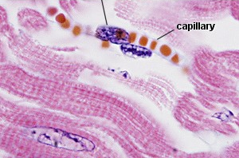
Concept Development
CFU 1
What is being carried out in capillaries?
CFU 2
Why do capillaries have the thinnest walls?
Capillaries
Are the smallest and most numerous of the blood vessels.
They are only one cell thick allowing exchange of nutrients and oxygen into body cells and transports wastes out of the cells.

Slide 31
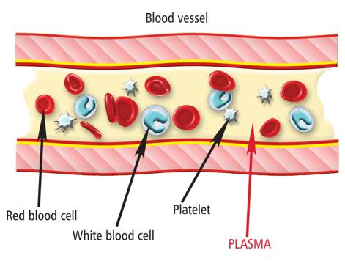
Concept Development
CFU 1
How much blood does the human body contain?
CFU 2
What are the four components of blood?
Blood
Is the only organ that exists as a liquid.
The human body has about 5.5 litres of blood.
It is made up of:
Plasma
Red blood cells
White blood cells
Platelets
It carries water, oxygen, nutrients and wastes.
Also helps maintain body temperature.
CFU 3
What is the purpose of the blood?
CFU 4
What does the blood help regulate within the body?

Slide 32
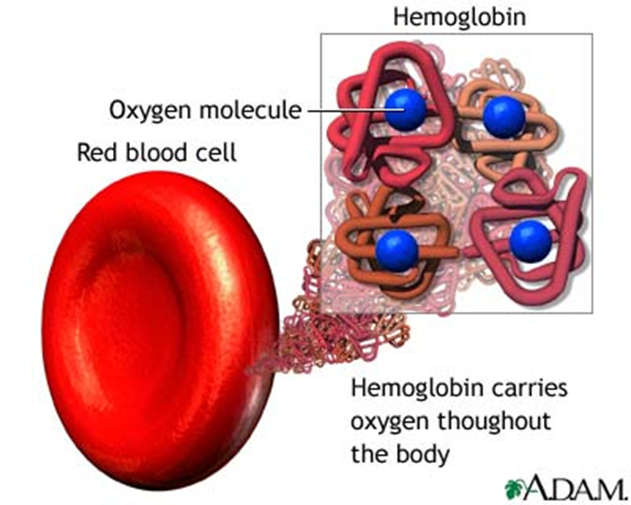
Concept Development
CFU 1
Where are red blood cells made?
CFU 2
What gives a red blood cell its colour?
Red Blood Cells
Are made in the bone marrow of long bones (e.g. femur – thigh bone) and ribs
Contains the chemical haemoglobin (gives blood the red colour; it contains iron)
Haemoglobin carries oxygen around the body.
They are disc-shaped and do not have a nucleus.
Also called erythrocytes.
CFU 3
Describe the shape and structure of a red blood cell.

Slide 33
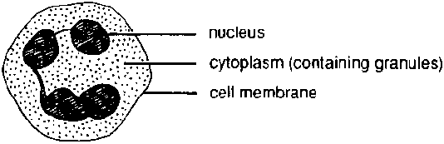
Concept Development
CFU 1
What is the difference between red blood cells and white blood cells?
CFU 2
What role do white blood cells have in the body?
Blood – White Blood Cells
Bigger than red blood cells, but less common.
They have no definite shape, but have a nucleus.
Help to fight diseases and infections.
They protect the body from disease by ‘eating’ foreign material and bacteria in the blood.
Also called leukocytes.
CFU 3
Describe how white blood cells protect the body.

Slide 34
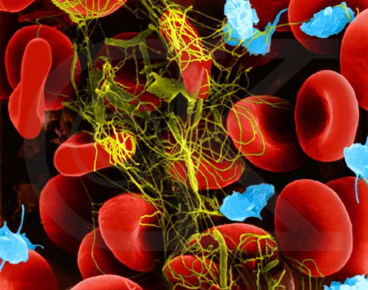
Concept Development
CFU 1
What are platelets?
CFU 2
What role do platelets play in the body? Explain how it works.
Platelets
Are tiny cells with no nucleus.
Platelets are made of broken bits of cells produced by the bone marrow.
Form sticky clots that plug up damaged blood vessels and stop bleeding.
Too many – causes clots to form in blood vessels (heart – angina; brain – stroke)
Too few – blood does not clot, causing excessive bleeding
Also called thrombocytes.
CFU 3
What happens if you have too few platelets?
Vocabulary
Clot: a thick mass of material stuck together

Slide 35
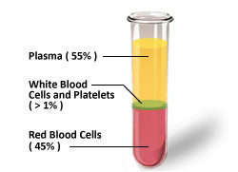
Concept Development
CFU 1
What is plasma?
CFU 2
What materials are dissolved in plasma?
Plasma
Is a clear, yellowish liquid that is mostly water.
Contains dissolved materials such as nutrients, hormones and wastes.
Red blood cells, white blood cells, and platelets are suspended in the plasma.
Helps regulate body temperature by transferring heat around the body.
CFU 3
How are the other blood components held in plasma?
CFU 4
What percentage does plasma make up in the blood?

Slide 36
Concept Development
CFU 1
What is the first step in a heart beat?
CFU 2
Where does the blood flow to from the atria?
The Heart Contracts and Relaxes
The heart beat begins when the heart muscles relax and blood flows into the atria.
The atria then contract and the valves open to allow blood into the ventricles.
CFU 3
Think, Pair, Share: What are the name of the valves between the atria and the ventricles?
blood from the body
blood from the lungs

Slide 37
Concept Development
CFU 1
What is the function of valves in the circulatory system?
CFU 2
What is the effect of contraction of the ventricles?
The Heart Contracts and Relaxes
The valves close to stop blood flowing backwards.
The ventricles contract forcing the blood to leave the heart.
At the same time, the atria are relaxing and filling with blood again.
The cycle then repeats continuously.
CFU 3
Think, Pair, Share: Consider this – how many times (on average) does a heart beat every day? 4,320 beats 103,680 beats 37,843,200 beats 2,838,240,000 beats
Fun Fact
With an average heart rate of 72 bpm: 4,320 beats an hour 103,680 beats a day 37,843,200 beats a year 2,838,240,000 beats a lifetime
https://www.youtube.com/watch?v=5tUWOF6wEnk

Slide 38
Concept Development
CFU 1
Why is the circulatory system a double pump system?
CFU 2
Explain the difference between the left and right sides of the ‘pump’.
Double Pump System
The circulatory system is a double pump system.
It is called this because there are two separate circuits through which the blood flows.
The right side deals with deoxygenated blood.
The left side deals with oxygenated blood.
Lungs
Body cells

Slide 39
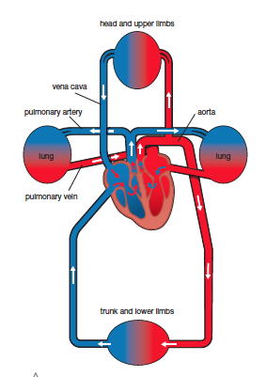
Concept Development
CFU 1
Explain the difference between the two pathways of blood in the body.
CFU 2
Think, Pair, Share: Where does deoxygenated blood flow to after leaving the heart?
Circulation in the Body
In one circuit, the blood flows from the heart to the body and back to the heart.
This circuit carries nutrients and oxygen to the cells.
At the cells, it collects wastes, including carbon dioxide.
The other circuit goes from the heart to the lungs.
In the lungs, carbon dioxide passes out of the blood and oxygen passes into the blood.
The blood rich in oxygen then returns to the heart to be pumped around the body.

Slide 40
Skill Development/Guided Practice
Describing the path of blood through the heart
1. Identify the starting point on the diagram 2. State whether the blood is oxygenated (red) or deoxygenated (blue) 3. Follow the arrows through the different parts of the body
Describe the path of blood from the lungs (3) to the heart.
The oxygenated blood returns to the heart through the pulmonary vein.

Slide 41
Skill Development/Guided Practice
Describing the path of blood through the heart
1. Identify the starting point on the diagram 2. State whether the blood is oxygenated (red) or deoxygenated (blue) 3. Follow the arrows through the different parts of the body
Describe the path of blood from the head and forelimbs(7) to the heart.
The deoxygenated blood returns to the heart through the vena cava.

Slide 42
Skill Development/Guided Practice
Describing the path of blood through the heart
1. Identify the starting point on the diagram 2. State whether the blood is oxygenated (red) or deoxygenated (blue) 3. Follow the arrows through the different parts of the body
Describe the path of blood from the right atrium (11) to the lungs (3).
The deoxygenated blood from the right atrium goes to the right ventricle, then goes through the pulmonary artery to the right and left lung.

Slide 43
Skill Development/Guided Practice
Describing the path of blood through the heart
1. Identify the starting point on the diagram 2. State whether the blood is oxygenated (red) or deoxygenated (blue) 3. Follow the arrows through the different parts of the body
Describe the path of blood from the left atrium (4) to the abdominal organs and hind limbs (8).
The oxygenated blood from the left atrium goes to the left ventricle, then goes through the aorta to the abdominal organs and hind limbs.

Slide 44
Skill Development/Guided Practice
Describing the path of blood through the heart
1. Identify the starting point on the diagram 2. State whether the blood is oxygenated (red) or deoxygenated (blue) 3. Follow the arrows through the different parts of the body
Describe the path of blood from the abdominal organs(8) to the lungs (3).
The deoxygenated blood from the abdominal organs goes through the vena cava to the right atrium, then the right ventricle. It then goes through the pulmonary artery to the lungs.

Slide 45
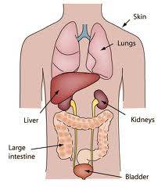
Concept Development
CFU 1
What is the function of the excretory system?
The Excretory System
Our bodies produce a number of substances that need to be removed to avoid damage to our bodies.
Organs in the excretory system are responsible for removing wastes from the body.
These organs include the kidneys, liver, lungs and skin.
CFU 2
Name two excretory organs.
CFU 3
What is excretion?
Vocabulary
Excretion - the process of getting rid of wastes.

Slide 46
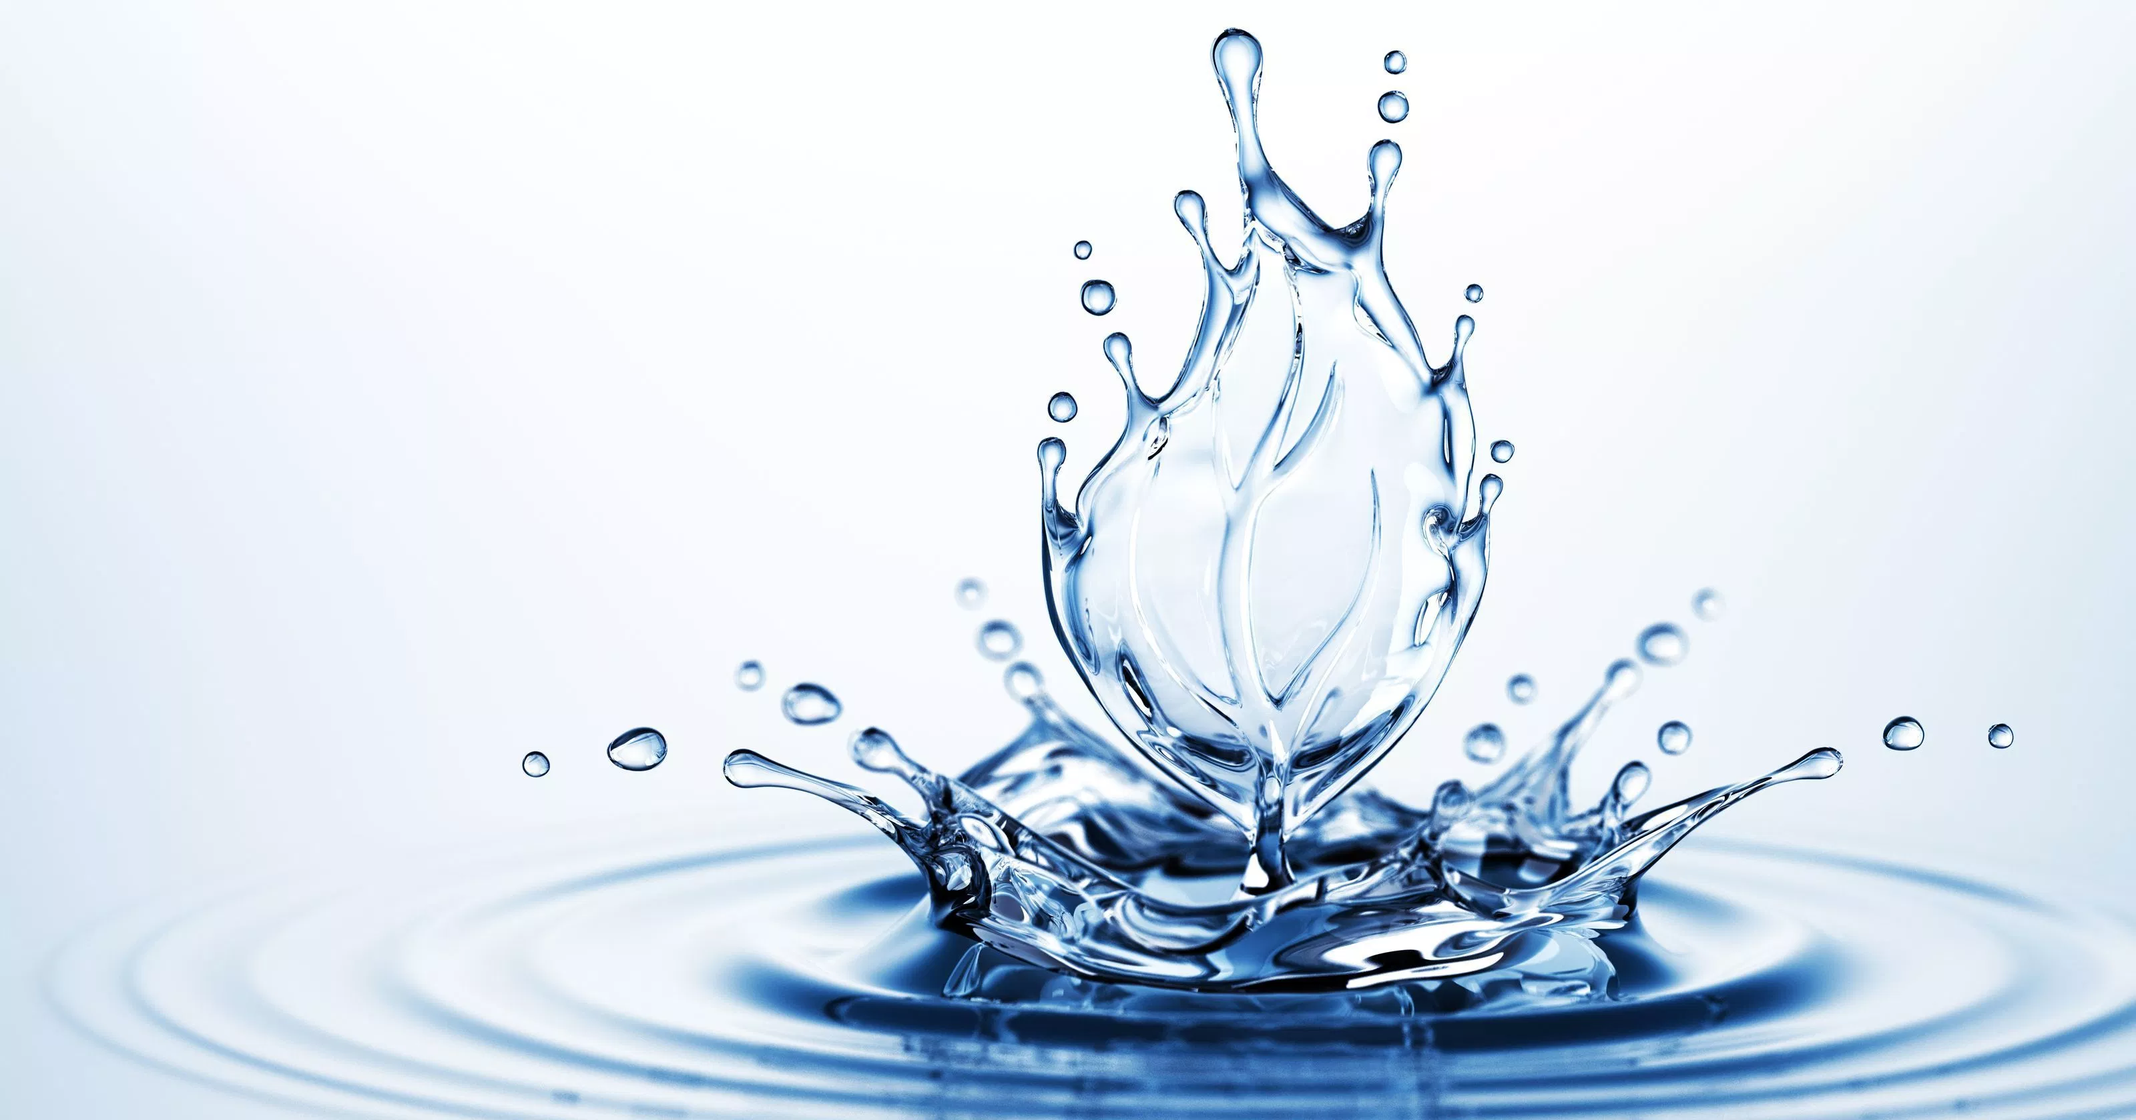
Concept Development
CFU 1
How does water play a part in excretion?
Role of Water
Water is important in controlling wastes.
It can dilute harmful substances, which reduces their impact on the body.
It also helps move substances quickly through the body.
It is essential in regulating body temperature.
Vocabulary
dilute (verb) Reduce the strength or concentration of a solution

Slide 47
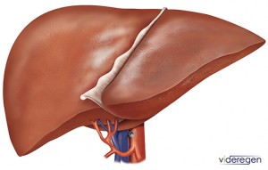
Concept Development
CFU 1
What is the liver responsible for?
The Liver
The liver is responsible for breaking down many substances, especially wastes.
It changes harmful substances into less dangerous forms before their removal from the body.
CFU 2
How does the liver process wastes?
CFU 3
Think, Pair, Share: What is another organ system that the liver plays a role in?

Slide 48
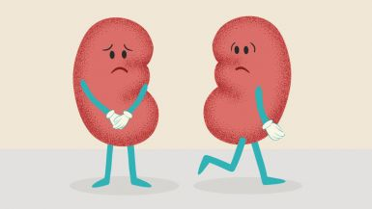
Concept Development
CFU 1
How many kidneys do you have?
CFU 2
What is the function of the kidneys?
The Kidneys and Bladder
You have two kidneys in your body.
Blood carrying waste products passes through the kidneys.
The kidneys filter waste from the blood.
At the end of the filtering process, there are two main products – clean blood and urine.
The bladder stores urine until it is released from the body.
CFU 3
What is produced after the filtering process?
CFU 4
What is the function of the bladder?

Slide 49
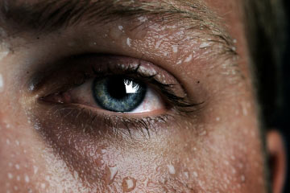
Concept Development
CFU 1
How does the skin release heat?
CFU 2
What is also contained in sweat?
The Skin
The skin releases waste heat by evaporation from wet skin (sweat).
Sweat also contains waste products such as urea and salt.

Slide 50
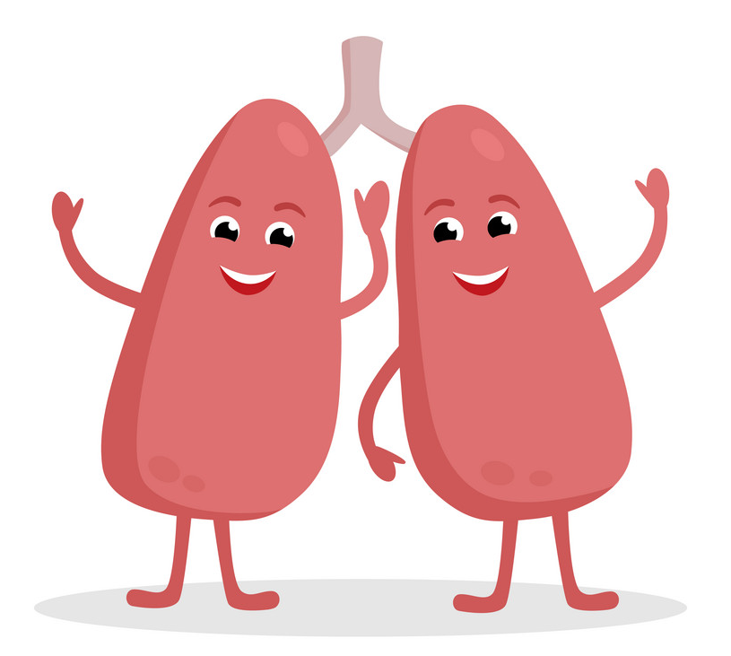
Concept Development
CFU 1
How is carbon dioxide transported to the lungs?
CFU 2
What happens to the carbon dioxide once it reaches the lungs?
The Lungs
Carbon dioxide is produced as a waste product in cells.
Blood carries the carbon dioxide to the lungs.
The carbon dioxide moves into the air inside the lungs and is breathed out.
CFU 3
Think, Pair, Share: In which structures in the lungs does gas exchange occur?

Slide 51
Concept Development
CFU 1
What are proteins broken down into?
CFU 2
What does the liver do to excess amino acids?
Excretory Organs Work Together
When proteins are digested, they are broken down into amino acids.
Your body cannot store excess amino acids, so the liver breaks them down further for energy.
This produces a harmful substance called ammonia, which the liver turns into a chemical called urea.
The urea is transported to the kidneys in the blood.
The kidneys filter out the urea, which leaves the body in urine.
CFU 3
What is produced when the liver breaks down amino acids?
CFU 4
What happens to the urea?

